Slide 1
Florida Association of Chamber Professionals
Creating a World-Class
Customer Service Culture

Slide 2
People who lack strong relationships have two to three times the risk of early death,
regardless of whether they smoke,
drink alcoholic beverages,
or exercise regularly.

Slide 3
It’s what you say and how you say it.

Slide 4
Saying, “Have a nice day” to someone sounds friendly.
But saying, “Enjoy your next 24 hours” sounds threatening.

Slide 5
It’s not just content.
Context matters, too.

Slide 6
I was trying to buy some organic fruit and asked the guy in produce if their apples had been sprayed with any poisonous chemicals because they were for my wife.
I should be done with my police interviews soon.

Slide 7
When You Are the Customer
Recall a poor customer service experience that you have had lately.
Recall a fantastic customer service experience that you have had lately.

Slide 8
Who Are Our Customers?
External?
Internal?

Slide 9
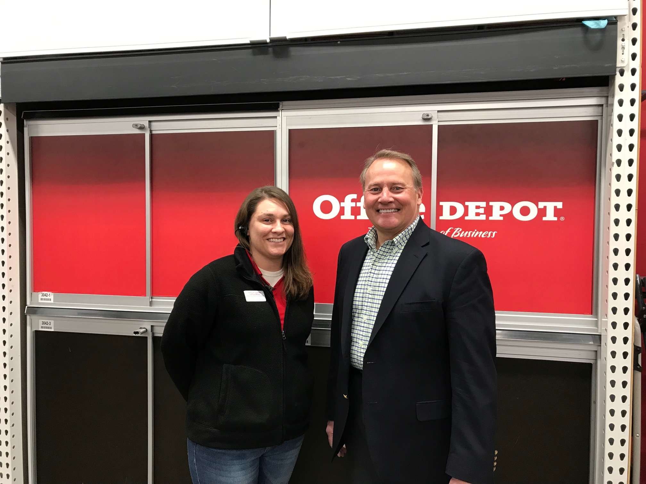

Slide 10
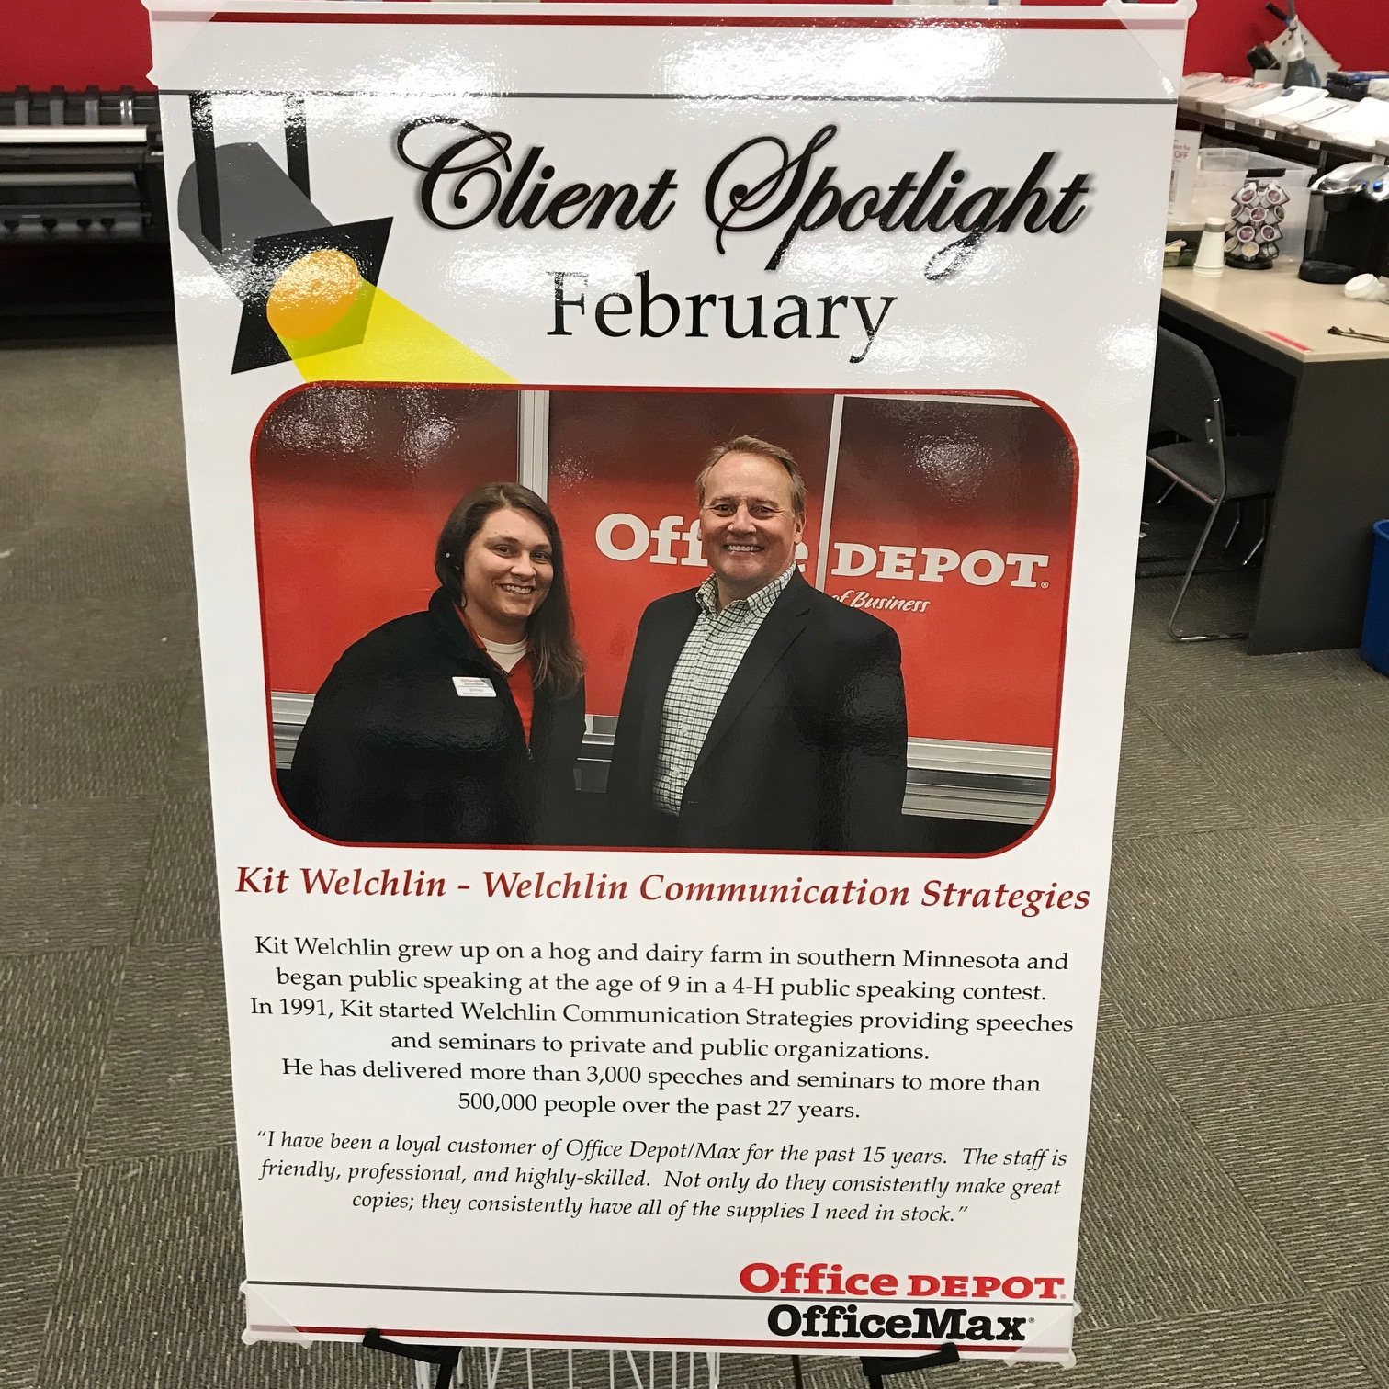

Slide 11
Service:
Greet guests with a pleasant attitude.
Experience:
Engage each guest personally and make the feel appreciated.

Slide 12
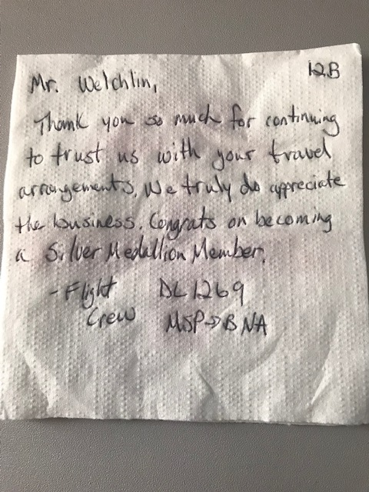

Slide 13
The Customer Service Model
Message
Self Other
Party
Feedback

Slide 14
The Five Laws of Customer Service
Law #1: Customer Service is a Process
Consistently:
Appear Warm & Friendly
Express Intentions and Motives
Demonstrate Trustworthiness
Be an Information Source
Develop Relevant Expertise
Project Dynamism

Slide 15
Service:
Show you are professional at what you do.
Experience:
Show you are professional and LOVE what you do.

Slide 16
Contrasting Perceptions
Tenant’s Perceptions
I always pay rent when she asks for it.
Landlady’s Perceptions
He never pays rent until I ask for it.

Slide 17
That’s a Transaction, Not an Experience
Service:
Handle transactions professionally.
Experience:
Make each interaction a memorable experience.

Slide 18
The Five Laws of Customer Service
Law #2: Customer Service is a Complex
6 Perceptions:
Who I think I am
Who I believe you think I am
And really who you think I am
Who you think you are
Who you believe I think you are
And really who I think you are

Slide 19
It may take people as little as 100 milliseconds to form an impression of another person – to decide whether he or she is attractive, trustworthy, competent and likable.
That’s less time than it takes to form a rational thought.

Slide 20
Your Personal Brand
Personality
Values
Emotional Rewards
Functional Benefits
Features

Slide 21
Enhancing Your Personal Brand
Principle of Resources
Principle of Scarcity

Slide 22
The Five Laws of Customer Service
Law #3: Messages Not Meanings are Communicated
Accuracy / Simplicity / Coherence
Language Intensity / Appropriateness
Statement Purpose
Explanation Picture
Examples Plan
Restatement Part they’ll Play

Slide 23
Effective Word Choice
Face – to – Face
7% - words
38% - voice
55% - body language

Slide 24
Effective Word Choice
On – the - Phone
20% - words
80% - voice

Slide 25
Effective Word Choice
In Writing - emails
100% - words

Slide 26
The Five Laws of Customer Service
Law #4: One Cannot Not Communicate
No matter what you say or don’t say
It’s also what you say and how you say it
Squarely face the other person
Tip your head – following along – Nod- agree
Attentive facial expressions
Barrier-free environment
Lean forward slightly
Eye contact (normal)

Slide 27
The Five Laws of Customer Service
Law #5: Two Elements:
Content and Relationship
Get it Done
Get it Right
Get Along
Get Appreciation

Slide 28
Four Intentions
Get “It” Done
Get “It” Right
Get Along
Get Appreciation

Slide 29
What If These Intentions Aren’t Fulfilled?
Get it Done – Controlling
Get it Right – Perfectionistic
Get Along – Approval Seeking
Get Appreciation – Attention Getting

Slide 30
What Could You Say So They Know:
You’re Going to Get It Done
You’re Going to Get It Right
You’re Getting Along
You Appreciate Them

Slide 31
The Customer Service Model
Message
Self Other
Party
Feedback

Slide 32
Identify & Improve Your Points of Encounter
First Hears about you – introduced to you
Makes contact with by Phone
Makes contact with you by email
Makes contact with you in Person
Waits to be served
Is Introduced to your products or services – your role
Tries your product or service – actions
Experiences your Follow Up
Encounters the way you Handle Problems

Slide 33
Telephone Techniques
Give the caller your Name
Speak into the phone
Keep your caller Informed
Invite the caller to get to the Point
Commit to requests of the caller
Thank the caller
Let your Voice fluctuate
Use Hold carefully
Be Friendly and Tactful

Slide 34
Tact is the art of making a point without making an enemy.
Isaac Newton

Slide 35
Telephone Tips
Don’ts and Do’s
We speak in words - many people think in pictures

Slide 36
Carefully choose the words you use and paint professional pictures in your customer and coworker’s minds.

Slide 37
Instead of saying, “I’ll have her call you.”
Say, “I will make sure she gets the message.”

Slide 38
Instead of saying, “He left early.”
Say, “He will be out of the office until tomorrow.”

Slide 39
Instead of saying, “He’s on break…”
“He’s out to lunch…”
“He’s down the hall…”
Say, “He is away from his desk at the moment.”

Slide 40
Instead of saying, “I haven’t seen her yet today.”
Say, “She is not in the office right now.”

Slide 41
Instead of saying, “He’s all tied up.”
Say, “He is in a meeting with his managers.”

Slide 42
Instead of saying, “She’s in the shower with a plumber right now.”
I should have said, “I will make sure she gets the message.”

Slide 43
So, carefully choose the words you use and paint professional pictures in your customer and coworker’s minds.

Slide 44
Telephone Tips
More Don’ts and Do’s

Slide 45
Instead of saying, “It sure took you long enough. Why didn’t you call sooner?”
Say, “Thanks for returning my call!”

Slide 46
Instead of saying, “We need to talk right this minute.”
Say, “Do you have a moment?”
or “Is now a good time?”

Slide 47
Instead of saying, “Of course they have my number – I’m returning their call.”
Say, “May I take your number (or leave my number) for quick reference?”

Slide 48
Instead of saying, “She went to buy another candy bar.”
Say, “She’s not in her office (or not available) at the moment.”

Slide 49
Instead of saying, “She’s out of state on vacation.”
Say, “She’s off site (or working out of the office) this week.”

Slide 50
Instead of saying, “Are you through yet?
or “Is that it?”
Say, “Will there be anything else?”

Slide 51
Instead of saying, “No problem.”
Say, “It will be my pleasure.”
or “I’d be happy to.”
or “Will do.”
or “Of course.”

Slide 52
Instead of saying, “You’ll have to…”
or “You’ll need to…”
Say, “I suggest you…”
or “I’d like to ask you to…”
or “I think the best way to handle this would be…”

Slide 53
Instead of saying, “We can’t do that.”
or “It’s company policy, so what can I do?”
Say, “Here’s what I can do for you.”

Slide 54
Instead of saying, “It’s not my job.”
Say, “The person who handles that is _____.
Let me get them on the line.”

Slide 55
Instead of saying, “I don’t know.”
Say, “Let me find that information for you.”

Slide 56
Instead of saying, “Are we through yet?”
Say, “I’m so glad you called.”
or “Thank you.”
or “You’re very welcome.”

Slide 57
Instead of saying, “Honey.” or “Buddy.”
Say their name (the way they wish it to be used) two times.

Slide 58
Customer Service on the Phone
Customer Judges:
Reliability / Responsiveness / Assurance / Empathy / Tangibles
The Next Time You Call a Professional Office
What memory did they create?
What is the memory you want to create?

Slide 59
Customer Service on the Phone
Taking Meaningful Messages
The date and time of the message.
The caller’s full name.
The organization’s name or the caller’s department.
The phone number.
The message.
Your name.

Slide 60
Customer Service on the Phone
The Art of Transferring Calls
Let the caller know that you are going to transfer the call.
Give the caller the name and phone number of the person you are transferring them to.
Preview the transfer process for the caller.

Slide 61
“Will You Hold, Please?”
Do’s and Don’ts
Do ask for permission.
Do tell them how long they will be on hold.
Check – 30 seconds – “Are you still able to hold?”
Do thank them for waiting.
Don’t use hold for more than 3 minutes.

Slide 62
Effective Telephone Interactions
Salutation: “Good morning.” “Good evening.”
Identification: “This is…” “You’ve reached…”
Solicitation: “How may I help you?”
Ending the Conversation: “Thanks for calling.”
“I enjoyed talking with you.”
“Good to hear from you.”
“Have a lovely day.” “Enjoy your evening.”

Slide 63
Complainers! Our Most Valued Customers!
1. Get into your “Effective” posture. STABLE
2. Take Notes on important points.
3. Listening Noises “I see” “I understand” “Go on”
4. Don’t Interrupt - Let them Vent.
5. Use the person’s Name to establish rapport.
6. Empathize - Visualize this person needing help.
7. Ask How & What questions - Clarify & Solve
8. Be Positive – Remember the Benefits
9. Confirm your Agreements
10. Follow Up

Slide 64
LEAD
Communicating with Complaining Customers
Listen
Empathize
Act
Demonstrate follow-up

Slide 65
LEAD
Listen
In today’s fast-paced environment, taking the time to actively listen is difficult. Active listening is one of the best tools for understanding customer service. Effective listening requires you to remove yourself from everything going on around you and give customers your 100% undivided attention. Ask the customer questions to seek understanding and to clarify what the customer means. Be patient.

Slide 66
LEAD
Empathize
Customers need validation that what they feel is “normal”. Being able to imagine how a customer feels about the situation (frustrated, disappointed, concerned, humiliated, stressed, scared, angry, worried, taken-advantaged-of, ignored, devalued etc.) is empathy.

Slide 67
LEAD
Act
All customer service must end with some action. Example: meeting is scheduled promptly, phone call returned quickly, delivery schedule modified, testing expedited, information shared, phone call transferred to a relevant expert, email sent immediately, faxing a copy of paperwork, contract re-submitted, etc. These actions have an enormously powerful effect on the way the customer feels about the organization, the service, and the people.

Slide 68
LEAD
Demonstrate follow-up
Managing customer expectations is never complete without immediate follow-up. Follow through and follow-up demonstrate that you care that the customer’s expectations and/or needs have been met and you did not forget about the customer’s concern. Customer service “all-stars” take follow-up even further by checking, again, with the customer or coworker through casual conversation that the expectations were met, the issue or problem has not reoccurred, and the solution to an issue or problem is still working. This additional follow-up demonstrates to the customer that the team really cares about the customer’s satisfaction.

Slide 69
LEAD
Describe Behaviors and Script Responses
Lengthy form
Length of time waiting
Common complaint

Slide 70
Pick Your Strategy
HQ/HS or LCP
High Quality / High Service Provider
or
Low Cost Provider

Slide 71
Pick Your Strategy
HQ/HS or LCP
Start with an Attitude of Gratitude.
Do an Organizational Reality Check.
Look in the Mirror.
Check the Appearance of your work area.
Be a Good Citizen.

Slide 72
Pick Your Strategy
HQ/HS or LCP
Take advantage - Communication Technology
Train your people well.
Exceed expectations – Information.
Exceed expectations – Speed.
Exceed expectations – Convenience.

Slide 73
Philosophy
If You’re Good to Your Customers
Underpromise - Overdeliver
Systems, not just smiles
Ask your customers what they Want
Identify 3 things
There’s no such thing as After hours

Slide 74
Philosophy
If you’re good to your Customers
Shop yourself
Manners really are important
Make sure Restrooms are immaculate
Look for customer service ideas to Borrow
Celebrate successes

Slide 75
Providing Better Customer Service
Determine how Good you want to be
Customer’s Point of View
Quantify the Lifetime Value of a customer
People who deal with customers - Authority
Is this something a Friend would charge for?

Slide 76
Providing Better Customer Service
When things gone wrong - Apologize and Fix
Explain to customers How you do things
Hire the Best people
Talk about your Heroes and Heroines
Measure Performance

Slide 77
In one minute I can change my attitude
and in that minute change my entire day.
If I was an actor I get paid to play a role.
At work I get paid to play a role.

Slide 78
If you would like additional information:
kit@welchlin.com
kit@seminarsonstress.com
Youtube/kitwelchlin Youtube/SeminarsOnStress
www.welchlin.com www.SeminarsOnStress.com

